Slide 1
Blue Broker Next Gen Real State Market
Name: Prathamesh Gaikwad(26)
Name: Aniket Jha(48)
Name: Vivek Jha(49)
Name: Sahil Kadam(50)
Date of presentation: 28/october/2023
Atharva College of Engineering
Department of Information Technology
2023-24
Notes:
1

Slide 2
Content
Introduction
Review of literature
Existing System
Problem Statement
Feasibility study and scope of project
Proposed system
Methodology
Block Diagram
Implementation
Datasets
Conclusions
Future Scope
Reference
2
ACE- IT department 2023-24 Blue Broker
Notes:
2

Slide 3
Introduction
Making buying and selling of real state property as liquid as a stock market trading.
Blue Broker is a Platform where you can buy and sell a property just like stock trading and gold trading.
It is profitable for both – The Buyer and Seller.
The Buyer Can easily buy a Part of the Property without having a lot to invest and can reduce the risk factor.
3
ACE- IT department 2023-24 Blue Broker

Slide 4
Literature Survey
SR.NO | Title | Author’s Name | Publisher | Year | Description
1. | Botswana Stock Exchange Listed Property Companies as an Alternative Indirect Real Estate Investment in Botswana | Prof. Shyamsundar Magar | Research Gate | 2020 | In this article the survey was taken and the property was listed to see if the person or investors wants to buy the whole property or the part of the property as an investment. Most of the people wanted a centralised system and were not convinced with the current system of real estate investment.
2. | A Systematic Review of Smart Real Estate Technology: Drivers of, and Barriers to, the Use of Digital Disruptive Technologies and Online Platforms | P. Iyappan, B. Nanthini Devi, P. Nivedha and V. Sayoojya | MDPI | 2021 | The Systematic use of technology can change the real estate market for good. Use of big9 technology makes the unorganised real estate market a organised sector.
4
ACE- IT department 2023-24 Blue Broker

Slide 5
3. | Indian real estate regulations and urban homebuyers: impact assessment | Neelam Chawla, Basanta Kumar | 2022 | Research Square | India released their Indian Real Estate law in 2016 with rules and regulations that helps the economy and save the buyer from loss. Each and every real estate bosy abides with this laws and should be compliant with this.
5
ACE- IT department 2023-24 Blue Broker

Slide 6
Problem Statement
In today's world if you want to buy or sell your property you go to a broker or contact the property owner.
You negotiate for the price and all this effort you get the worst market rate.
Using a Centralized system for all this is the best thing an as it will take less effort and will make buying and selling of property easy and a great investment option for anyone.
You can buy a part of the property as an investment or the whole property according to your capital.
6
ACE- IT department 2023-24 Blue Broker

Slide 7
Feasibility study
market Research: Thoroughly research the demand for fractional property investments and assess competition.
Regulatory Compliance: Determine the legal and regulatory requirements for operating in different regions, and budget for compliance.
Technical Infrastructure: Assess the technical feasibility and costs of developing a robust platform for property transactions.
Revenue Models: Develop sustainable revenue models, such as transaction fees, management fees, or subscription plans.
ACE- IT department 2023-24 Blue Broker

Slide 8
Proposed Solution
In our proposed system we are going to create a web app where users can list their property and can divide the property into lots like an IPO in the stock market.
Then this property will be listed in the market. People can buy parts of the property and can sell according to the market gain or loss. After buying a part of the property they will get a registration form and all the information.
They can sell their property part after 3 days of buying it and can get the settlement amount within 1 week.
This will make the real estate market more liquid and easier for investors.
8
ACE- IT department 2023-24 Blue Broker

Slide 9
Methodology
Block Diagram
Implementation
datasets
ACE- IT department 2023-24 Blue Broker

Slide 10
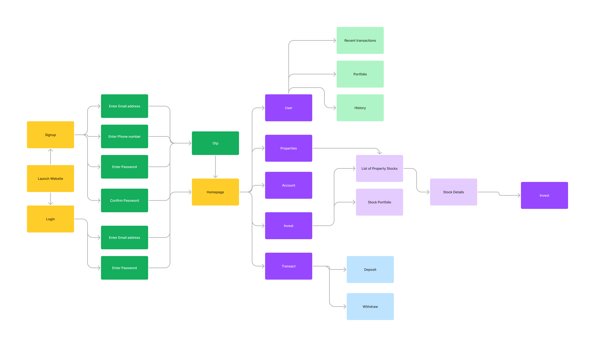
Block Diagram
10
ACE- IT department 2023-24 Blue Broker

Slide 11
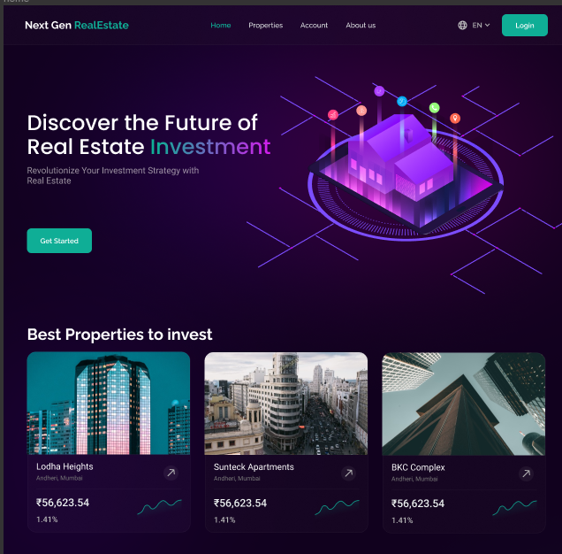
Implementation
ACE- IT department 2023-24 Blue Broker

Slide 12
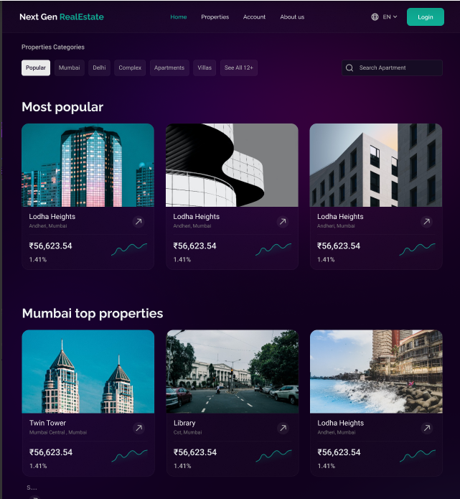
ACE- IT department 2023-24 Blue Broker

Slide 13
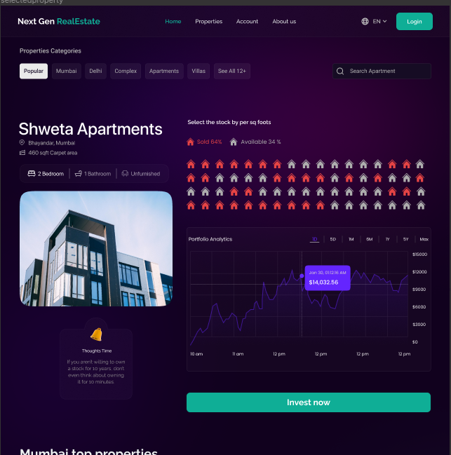
ACE- IT department 2023-24 Blue Broker

Slide 14
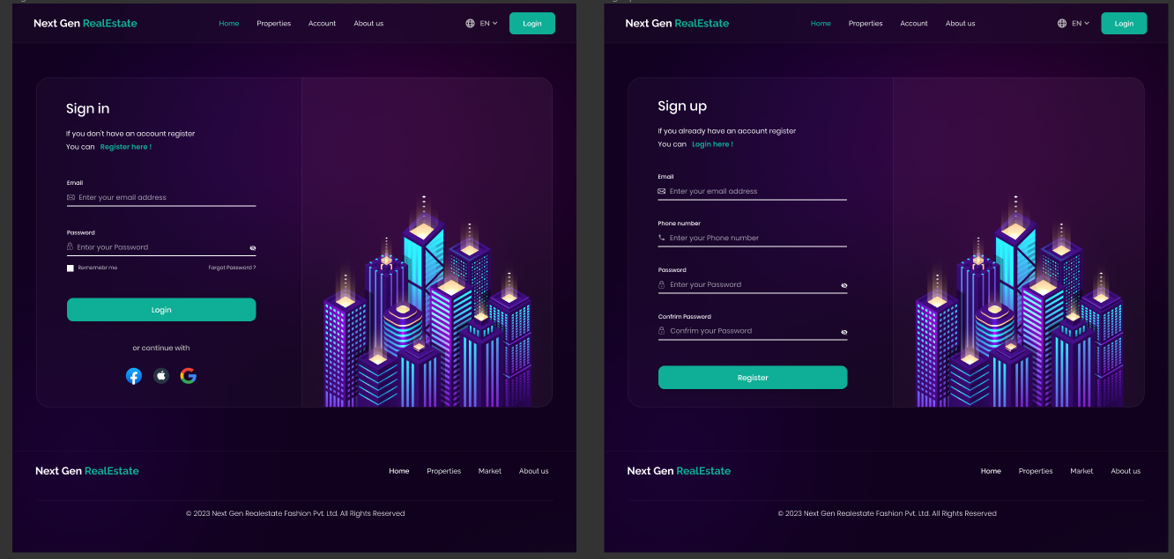
ACE- IT department 2023-24 Blue Broker

Slide 15
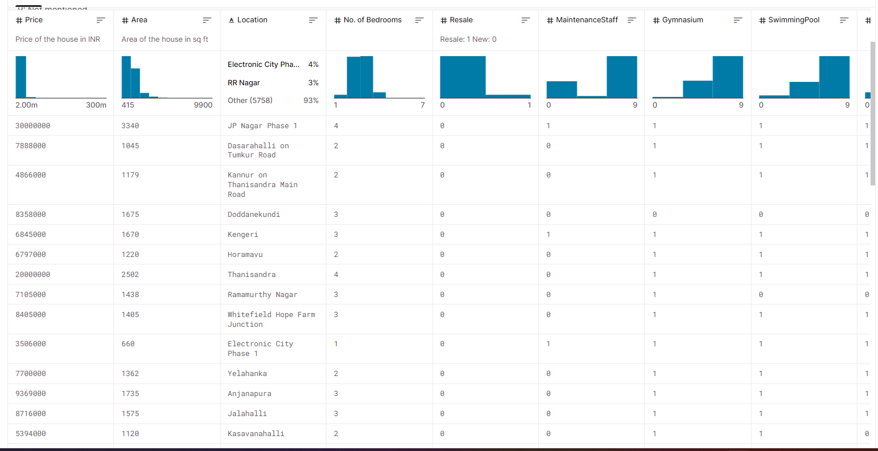
Dataset
https://www.kaggle.com/datasets/ruchi798/housing-prices-in-metropolitan-areas-of-india
This dataset comprises data that was scraped. It includes:
collection of prices of new and resale houses located in the metropolitan areas of India
the amenities provided for each house
ACE- IT department 2023-24 Blue Broker

Slide 16
Conclusion
Using Website Development Technology and Machine learning we have created a next generation real estate website where you can buy and sell any property in parts and don't have to worry about huge investment and risks
ACE- IT department 2023-24 Blue Broker

Slide 17
Future Scope
Market Growth: The real estate market is expanding, and fractional property investment aligns with the growing trend of democratizing access to real estate.
Diversification: Fractional property investments allow users to diversify their portfolios beyond traditional stocks and bonds, appealing to a wide range of investors.
Global Expansion: Potential to expand the platform globally, offering access to various international real estate markets.
Secondary Market: Introduce a secondary market where users can trade their fractional property shares, enhancing liquidity.
ACE- IT department 2023-24 Blue Broker

Slide 18
Reference
Abdul-Rasheed, A., &Tajudeen, A. (2006). Performance analysis of listed construction and real estate companies in Nigeria. Journal of Real
EstatePortfolio Management, 12(9), 177-186.
Al-Marwani, H. A. (2014). An approach to modeling and forecasting real estate residential property market (Doctoral dissertation).
Alexander, G. J., Sharpe, W. F., & Bailey, J. V. (2001). Fundamentals of investments. Pearson College Division.
Amidu, A. R., TajudeenAluko, B., &BamideleOyedele, J. (2008). Price formation in residential property market: evidence from FGLP auction in
Nigeria. Property Management, 26(4), 228-240.
ACE- IT department 2023-24 Blue Broker

Slide 19
Questions??
Thank You!
19
ACE- IT department 2023-24 Blue Broker

